Slide 1
Case study title
Ajewole Tolulope

Slide 2
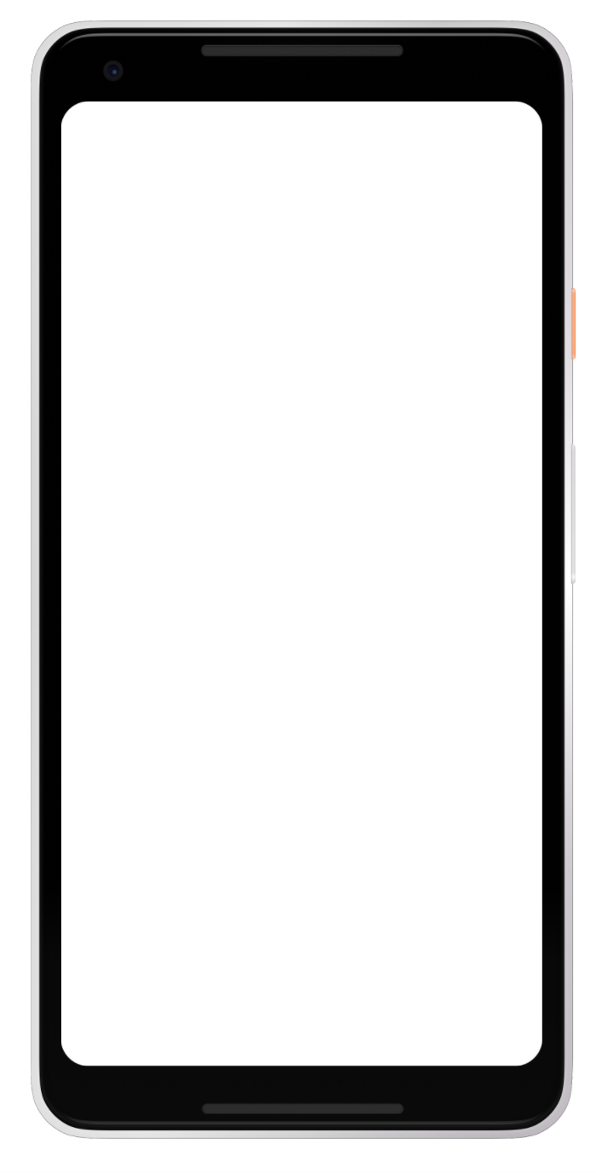
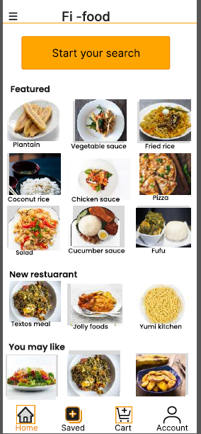
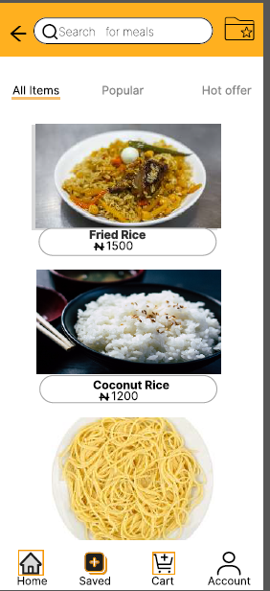
Project overview
The product:
Fi-food App is a restaurant locator app and also help user to order from the restaurant, it acheives this by allowing the user to search for restaurant by location and also allow them to order from the restaurant.
Project duration:
May 2022 – July 2022

Slide 3
Project overview
The problem:
People find it hard to locate restaurant near them, especially a guest or a tourist
The goal:
Design an app that can help the user locate a nearby restaurant and also order food from the restuarant

Slide 4
Project overview
UX designer designing an app for Fi –food App from conception to delivery.
My role:
Responsibilities:
Conducting interviews, paper and digital wireframing, low and high-fidelity prototyping, conducting usability studies, accounting for accessibility, and iterating on designs.

Slide 5
User research
Personas
Problem statements
User journey maps
Understanding
the user

Slide 6
User research: summary
I conducted interviews and created empathy maps to understand the users I’m designing for and their needs. A primary user group identified through research was tourists or guests that wants to order food from nearby restaurant by first searching for them.
The user group wants to be able to search for nearby restaurant and be able to order food from them at the comfort of their home or workplace.

Slide 7
User research: pain points
1
2
3
Stress
Accessibility
Disapointing
Tourist don’t want to have to be searching for restaurant in their new location
Some food ordering App did not have a platform to customize and track my order
Some restaurant search app include some non existing restaurant in their search results

Slide 8

“
Persona: Zareen
Problem statement:
Zareen is a guest in a new location
who needs to be able to locate and order food from a nearby restuarant
because he does not want to undergo the stress of searching for restaurant near his new location.
Goals
To be able to perform my assignment.
To maintain a work healthy life balance.
To enjoy a stress free tour while on assignment in different location.
Frustrations
Stress of searching around for restaurant in my new location.
Having to shift focus from brainstorming for new engineering ideas to thinking on how and where to eat
Name: Hassan
Age:
Education:
Hometown:
Family:
Occupation:
33
B.Engineering
Ilorin,Kwara
Single, lives alone
Engineer
Hassan is an Agricultural Engineer in a large firm, he is saddled with the responsibility of traveling from location to location, he is also frustrated having to start going around to search for restaurant near his new location, he will be glad if he can get a platform that can be of help

Slide 9
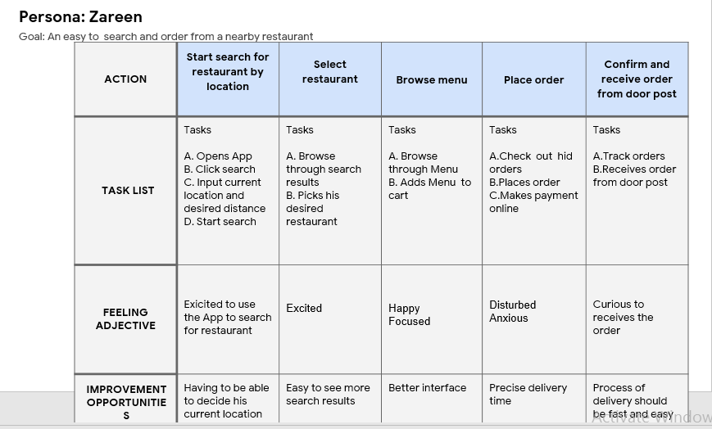
User journey map
[Your notes about goals and thought process]
Image of user journey map

Slide 10
Paper wireframes
Digital wireframes
Low-fidelity prototype
Usability studies
Starting
the design

Slide 11
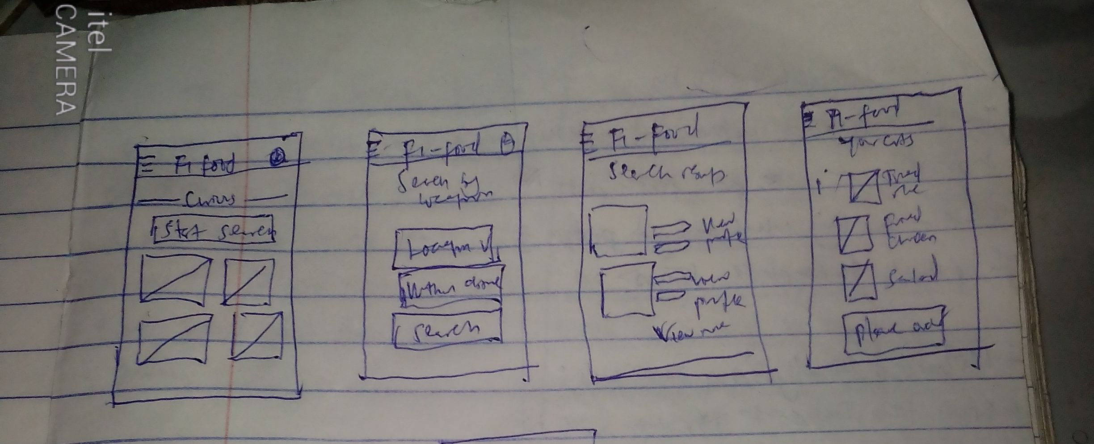
Paper wireframes
Taking the time to draft iterations of each screen of the app on paper ensured that the elements that made it to digital wireframes would be well-suited to address user pain points. For the home screen, I prioritized a quick and easy ordering process to help users save time.

Slide 12
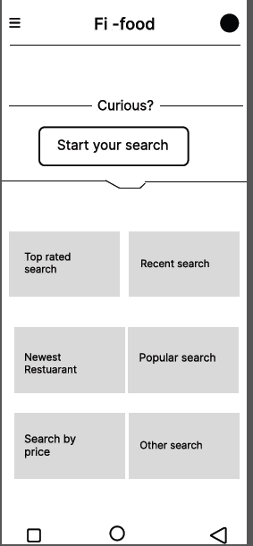
Digital wireframes
As the initial design phase continued, I made sure to base screen designs on feedback and findings from the user research.
Search button that allows user to search for restaurant by location
Button gives user access to their recent search

Slide 13
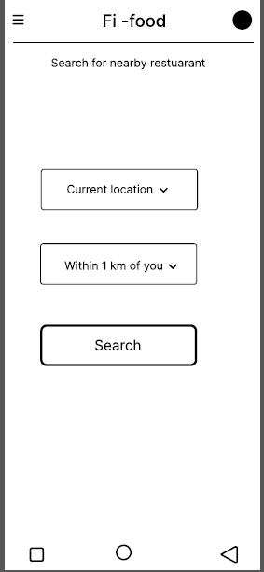
Digital wireframes
User is allowed to decide on their location and your distance
Button allows user to insert their current location.
Button allows user to select their desired distance

Slide 14
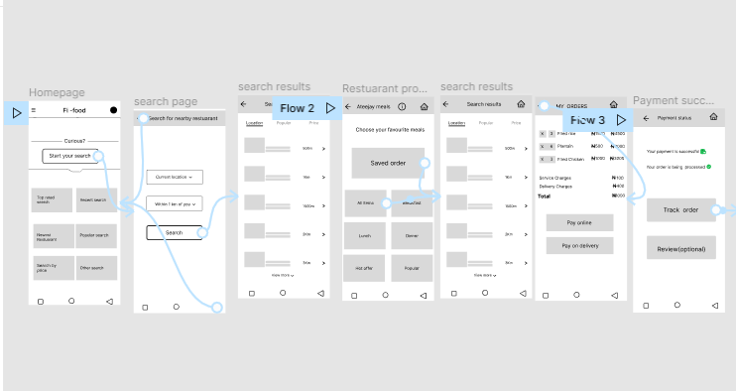
Low-fidelity prototype
Using the completed set of digital wireframes, I created a low-fidelity prototype. The primary user flow I connected was locating and ordering food from the restaurant, so the prototype could be used in a usability study.
View the FI- food
low-fidelity prototype

Slide 15
Usability study: findings
I conducted two rounds of usability studies. Findings from the first study helped guide the designs from wireframes to mockups. The second study used a high-fidelity prototype and revealed what aspects of the mockups needed refining.
Round 1 findings
Round 2 findings
1
User wants to be able to customize their order
1
Visual hierachy should be revisited
2
User wants the search results to be arranged in the ascending order of the distances
2
Animation used is not user accessibility defined
3
User wants to be able to view food details

Slide 16
Refining
the design
Mockups
High-fidelity prototype
Accessibility

Slide 17
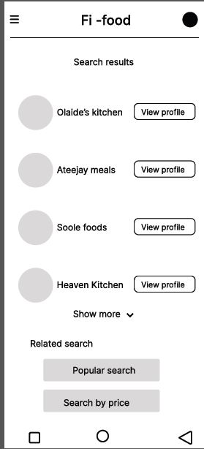
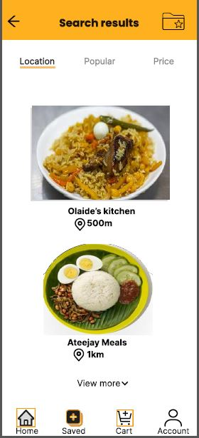
Mockups
Before usability study
After usability study
Earlier I designed the app showing search results of restaurant with their profile but after the usability study I saw the need for the restuatant to be arranged in the ascending order of the distances from the users location.
Image of selected screen after usability study

Slide 18
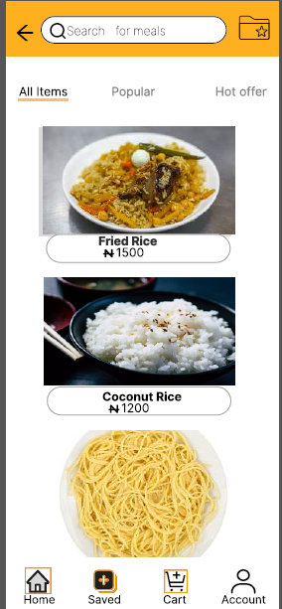
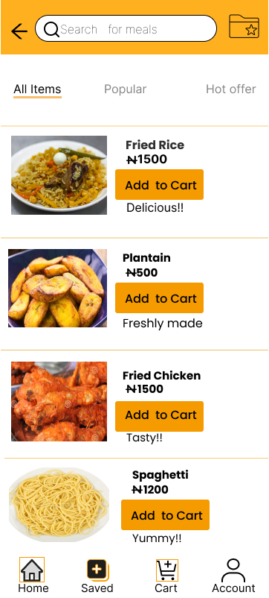
Mockups
Before usability study
After usability study
My earlier design did not allow users to be able to add food items to Cart, my refined allows users to do that with ease.
Image of selected screen before usability study
Image of selected screen after usability study

Slide 19
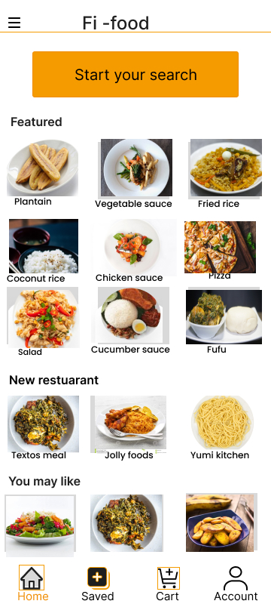
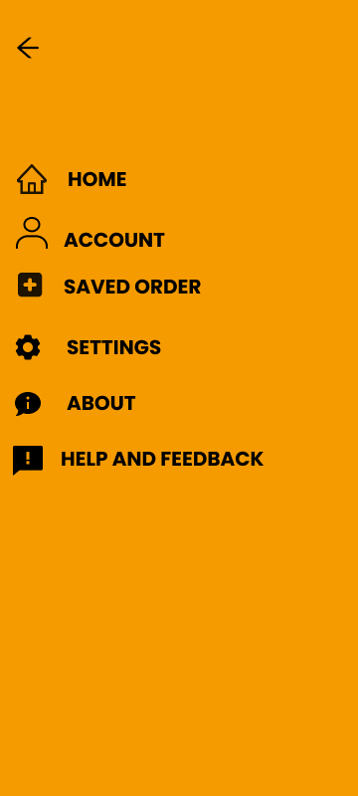
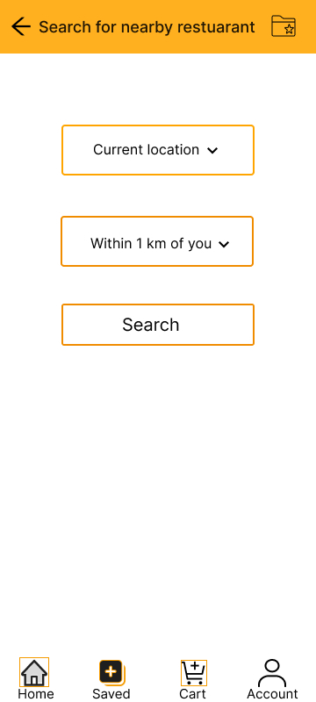
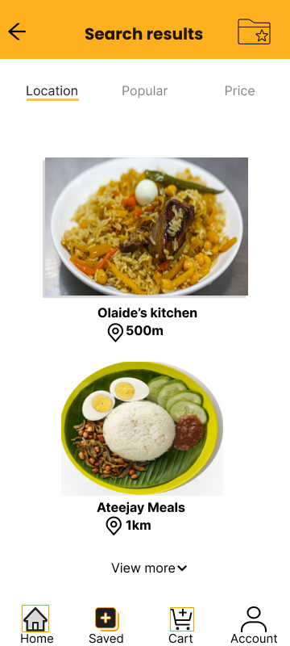
Mockups
Main mockup screen for display
Main mockup screen for display
Main mockup screen for display
Main mockup screen for display

Slide 20
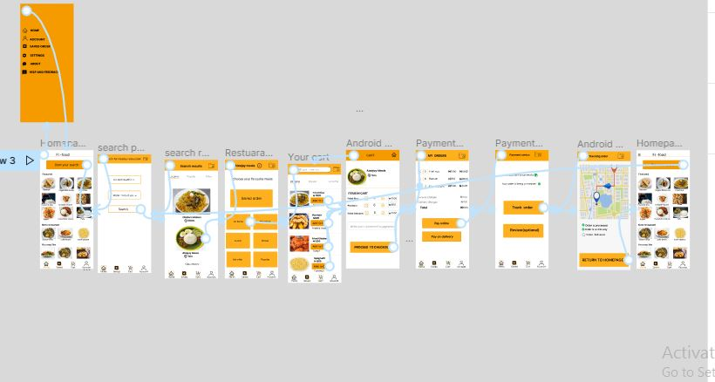
High-fidelity prototype
The final high-fidelity prototype presented cleaner user flows for searching and ordering food from a nearby restuarant. It also met user needs for delivery as well as more customization.
View the Fi-food App high-fidelity prototype
Screenshot of prototype with connections or prototype GIF

Slide 21
Accessibility considerations
1
2
3
Provided access to users who are vision impaired through adding alt text to images for screen readers.
Allows user to be able to make decision by providing them with options
Used icons to help make navigation easier.

Slide 22
Going forward
Takeaways
Next steps

Slide 23
Takeaways
Impact:
The app makes users feel no stress while moving into new location.
One quote from peer feedback:
“The app made it so easy to search and order food from restaurant near me
What I learned:
While designing the Fi food app, I learned that the first ideas for the app are only the beginning of the process. Usability studies and peer feedback influenced each iteration of the app’s designs is important.

Slide 24
Next steps
1
2
3
Conduct another round of usability studies to validate whether the pain points users experienced have been effectively addressed.
Try to liaise with engineers for a possibility of bringing the App to life
Conduct more user research to determine any new areas of need.

Slide 25
Insert a few sentences summarizing the next steps you would take with this project and why. Feel free to organize next steps in a bullet point list.
Let’s connect!
Thank you for your time reviewing my work on the Fi food app! If you’d like to see more or get in touch, my contact information is provided below.
Email: tjoel0098@gmail.com
Website: Still in progress

Slide 26
Thank you!

